Slide 1
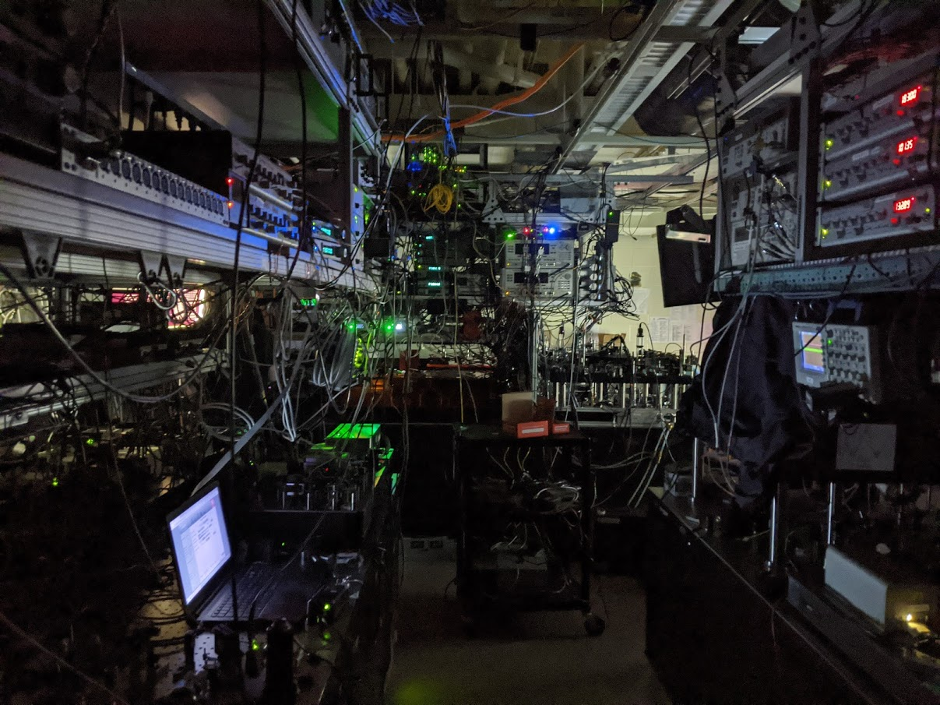









Trent Graham
Y. Song
J. Scott
L. Phuttitarn
K. Jooya
P. Eichler
X. Jiang
A. Marra
B. Grinkemeyer
M. Kwon
M. Ebert
J. Cherek
M. Lichtman
M. Gillette
J. Gilbert
T. Balance
C. Campbell
E. D. Dahl
T. Noel
Mark Saffman
wqi.wisc.edu

Slide 2
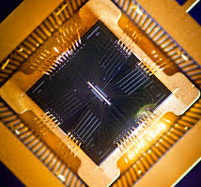
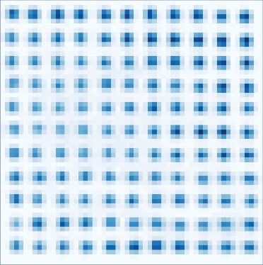
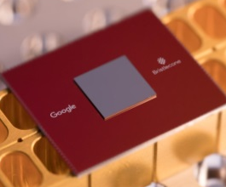
Quantum Computing Platforms
trapped ions
neutral atoms
Atomic qubits (identical)
Room T apparatus (or 4K)
Optical interface/qu. networking
Laser cooling and control
optical
superconductors
quantum dots
Scalability challenging
Engineered qubits (not identical)
Requires cryogenic cooling
No optical interface
Microwave electronics

Slide 3

The atomic advantage: Isolation & Control
Laser cooled atoms trapped by light in vacuum.
Superb quantum memory with coherence from seconds to minutes.
Selective control using laser pulses
Excitation of Rydberg state provides superstrong interactions and fast logic operations.
Superstrong interaction
Rydberg
atoms
Laser pulse
on/off ratio 10¹²
Neutral atoms trapped by light
Quantum properties maintained for seconds to minutes.
Neutral atom experiments at: UW, Harvard, Princeton, Caltec, Penn State, UChicago, Wuhan, KAIST, Institut d'Optique, etc. + ColdQuanta, QuEra, Atom Computing, PASQAL

Slide 4
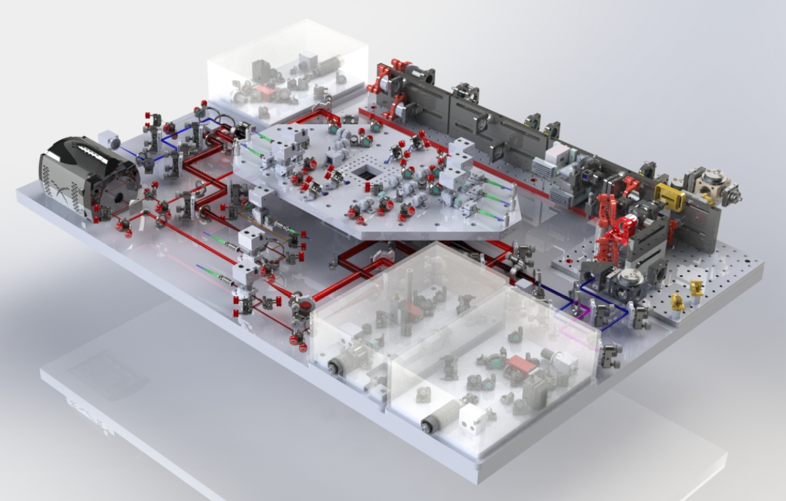
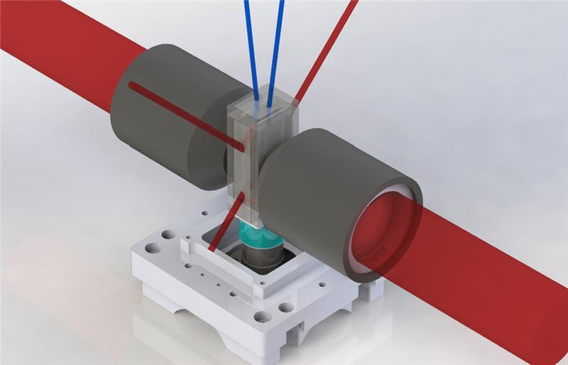
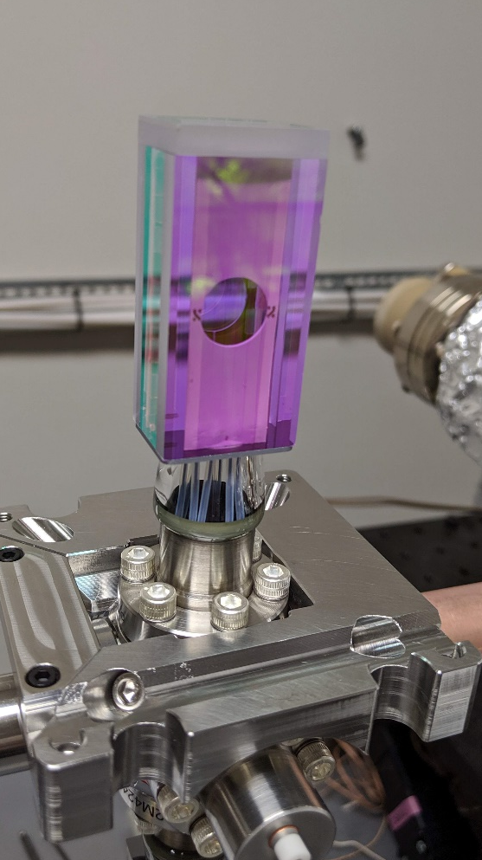
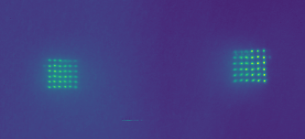
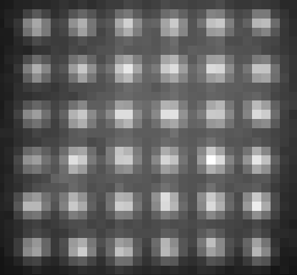
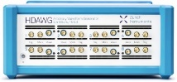
New machine
825 nm blue array and axial lattice
UHV cell with
electrodes
QPU
459 nm
Rydberg
scanner
cooling light
Cooling & imaging
optics
camera
dynamic
line array
NA 0.7
Control system, Lasers & electronics upgrades
Atom
rearranger
1038 nm
Rydberg
scanner
Individual and dual atom addressing.
New gate protocols and circuits under test.
Running arbitrary quantum circuits.

Slide 5
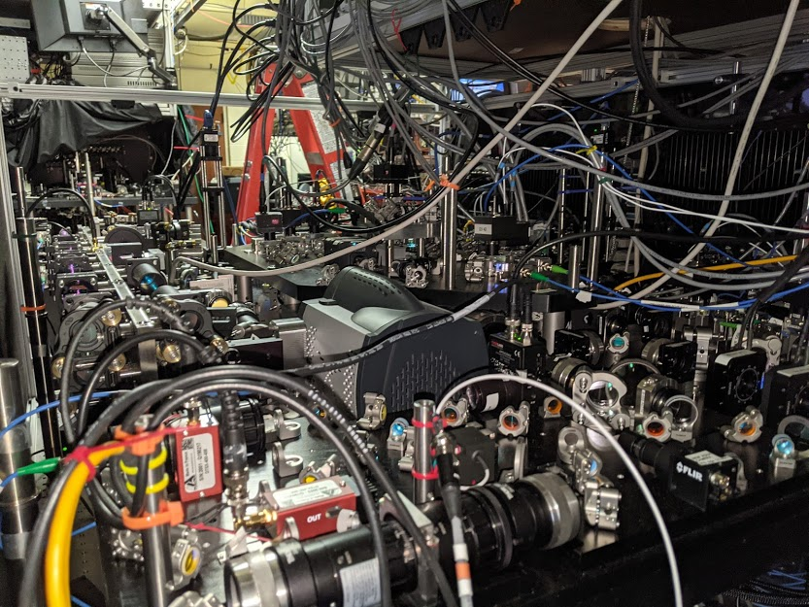

Slide 6
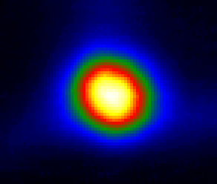
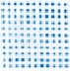
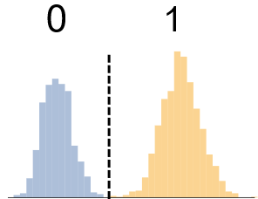
Operational Sequence
Qubit Register Preparation
Calculation Cycle
Cold
Atoms
Single Atom
Array
Filled
Array
State
Initialization
Quantum
Circuit
Measure
Results
1
0
f=4
|1>
Cesium
f=3
|0>
Camera
Camera
Camera
Optical Pumping
895 nm laser
Gates
1Q, 2Q
459 nm, 1040 nm lasers, μwaves
Laser cooling
852,894 nm lasers
Array
825 nm lasers,
Deep cooling
Rearrange-ment
1064 nm
laser
852 nm lasers
Controlling the Mechanics
Controlling the Quantum

Slide 7
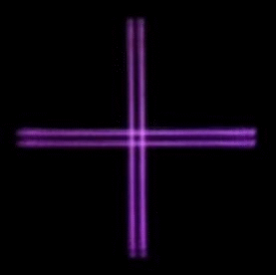

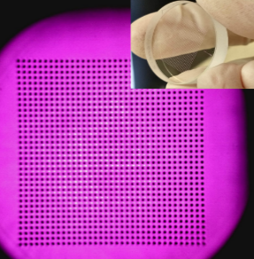
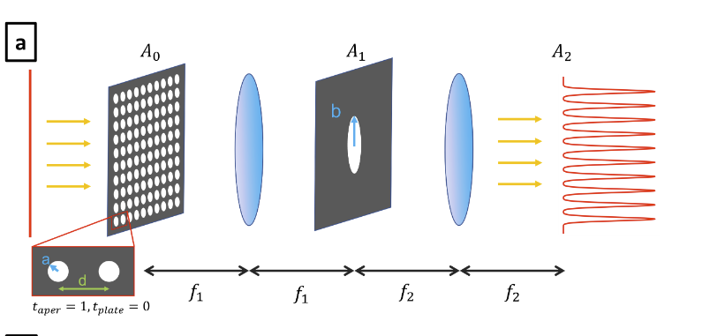
Scalable qubit registers
Dynamic line array
Up to 500 sites, currently in use.
Gaussian line array
Hole array
Scalable to >10⁴ sites
Component
1225 sites
Averaged loading image

Slide 8
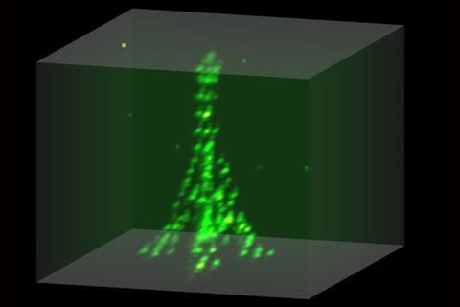

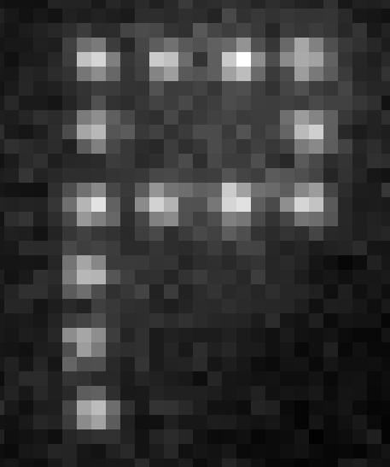
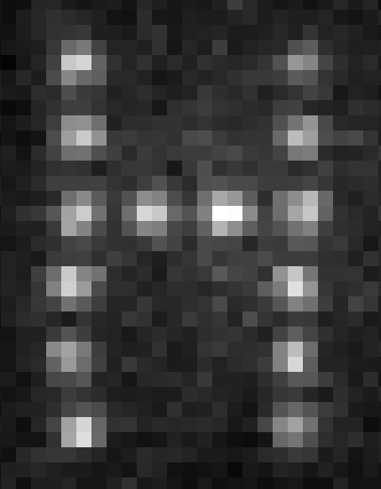
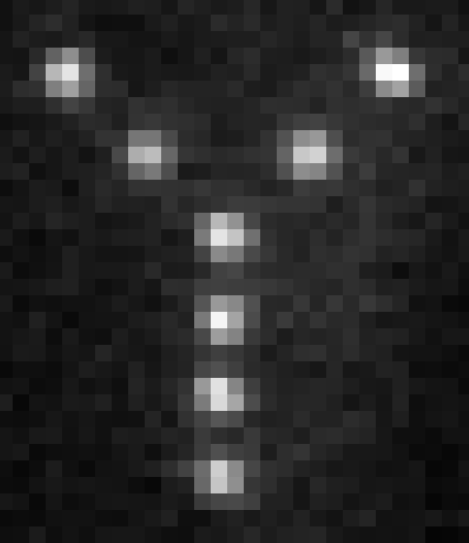
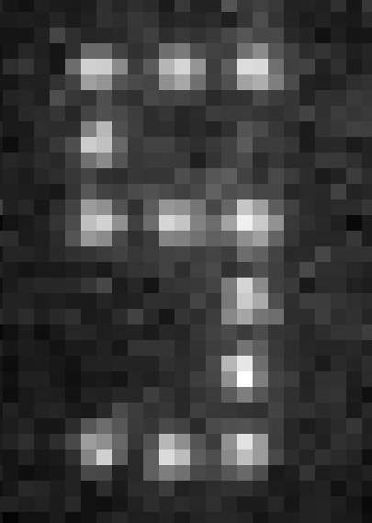
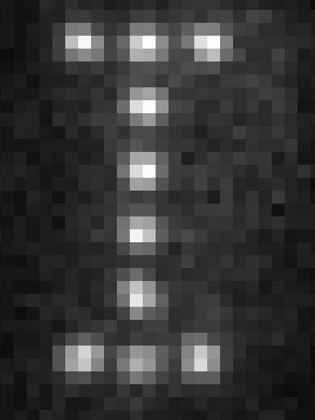
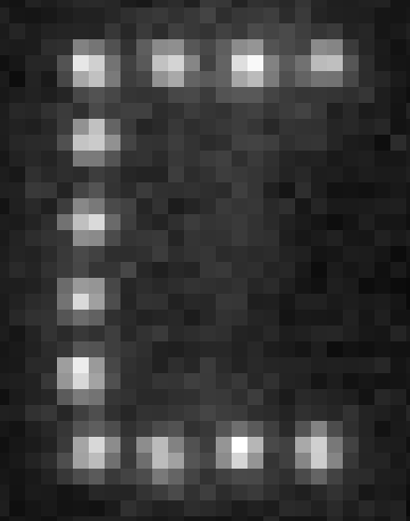
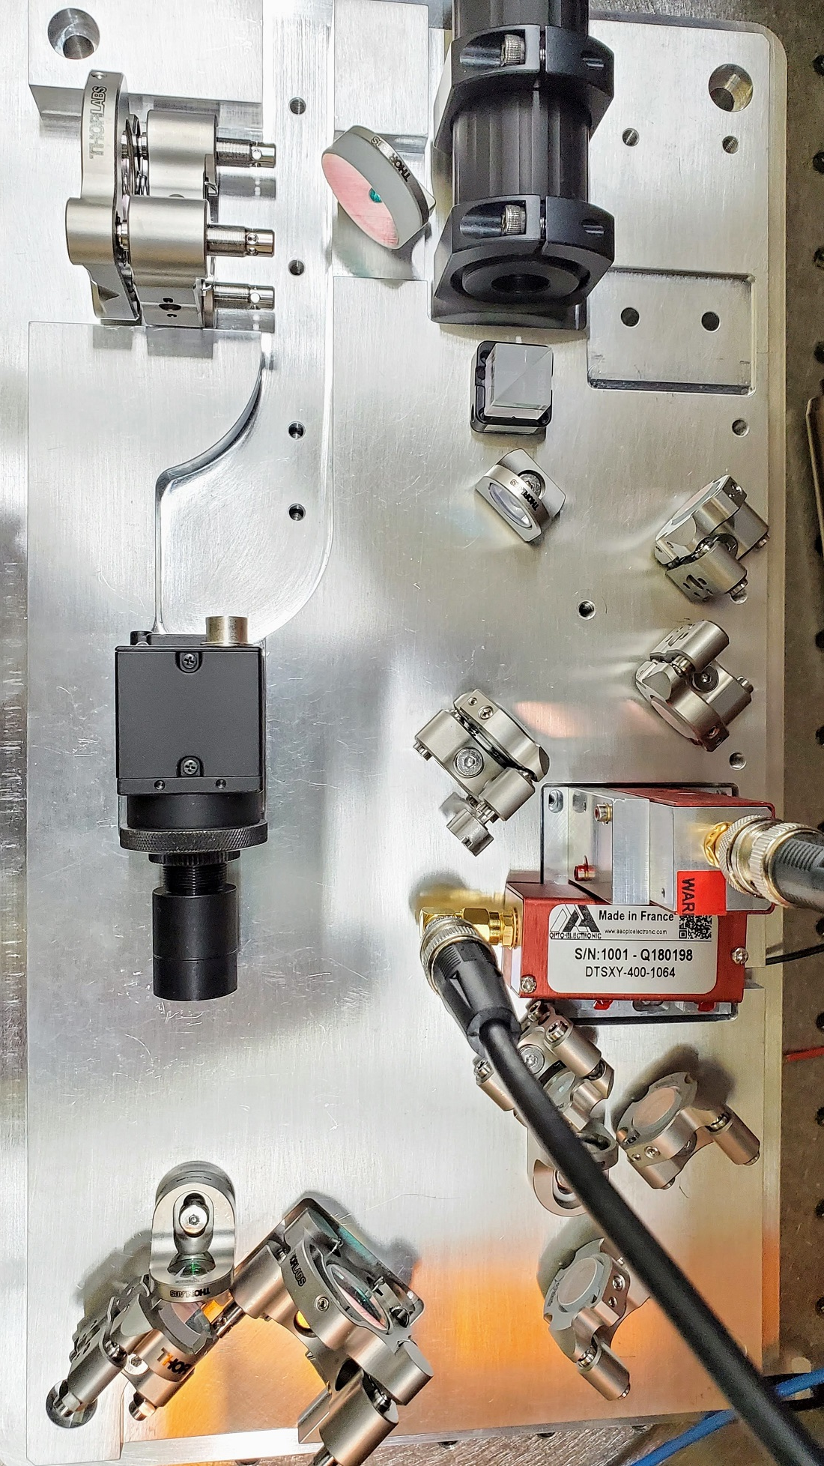
Atom Rearrangement
Loading single atoms into a trap array
is a stochastic process.
The array is deterministically filled using
“atom rearrangement”.
Works in 1D, 2D, 3D
KAIST, Paris, Harvard, Darmstadt, Wuhan,
Moscow, ….
Gaussian line array
Gaussian line array
Browaeys group (2019)
2D acousto-optic scanner
25x25=625 site spot array
3 μm

Slide 9
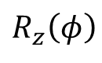
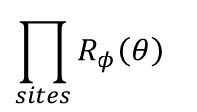
Gate set
Cs
f=4
Encode in Cs clock states:
Universal gate set:
Global gates
microwaves
Single site optical
Stark shift
|1>
9.2 GHz
f=3
|0>
m_{f}=0
$$\prod_{sites}{R_{φ}\left(θ\right)}$$
Rydberg blockade
Angle φ in x-y plane
from μwave phase
i,j site indices or more
$$R_{z}\left(φ\right)$$
Native multi-qubit gates are also possible: (CNOT)^{k}, C_{k}NOT. Toffoli k=2 demonstrated at Harvard.

Slide 10
Improved 2Q gate fidelity – Joint Illumination
Arbitrary waveform generator drives acousto-optic deflector with two tones to target two atoms.
Deflector frequency shifts are opposite for the two photons of the transition
Individual addressing of sites 9 um apart.
Used Harvard protocol with parameters modified for weak blockade.
9 μm
H. Levine, et al. PRL 123.17 (2019)
Bell Fidelity =0.93 +/- .01 (raw)
=0.96 +/- .01 (SPAM corrected)
0
π
2π
Beam waist w=3.3 μm
d=9 μm
75s state
B_{field}=16 G
B/2π=3.0 MHz
Ω/2π=1.7 MHz
Bell Fidelity Average over 6 gates =0.90 (raw)
~0.92 (corrected)
arXiv:2112.14589 (2021)

Slide 11
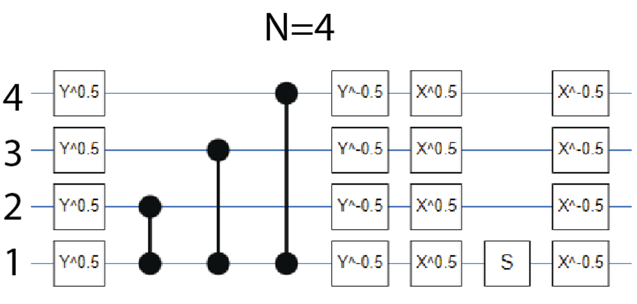
GHZ states
A good test of the computer is preparation of entangled GHZ states

Slide 12
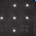
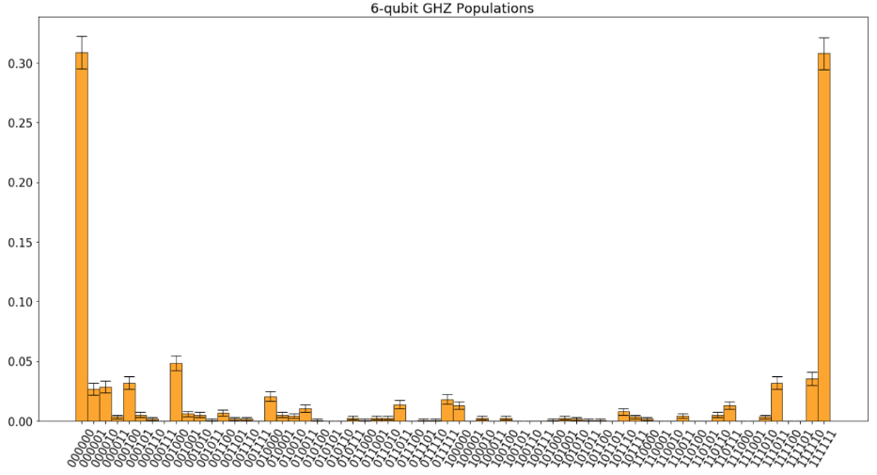
GHZ states
0.3
N=6
0
arXiv:2112.14589 (2021)

Slide 13
Phase estimation
Quantum phase estimation is one of the most important quantum algorithms. Useful for quantum chemistry and factoring.

Slide 14
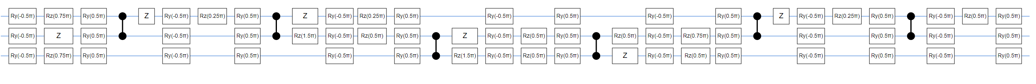
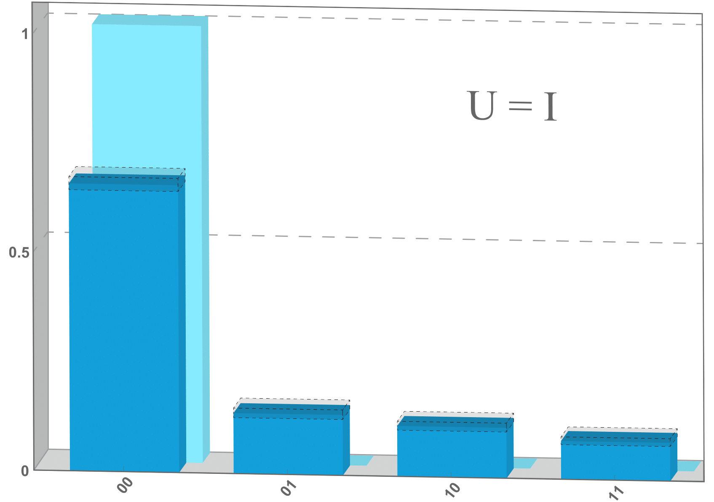
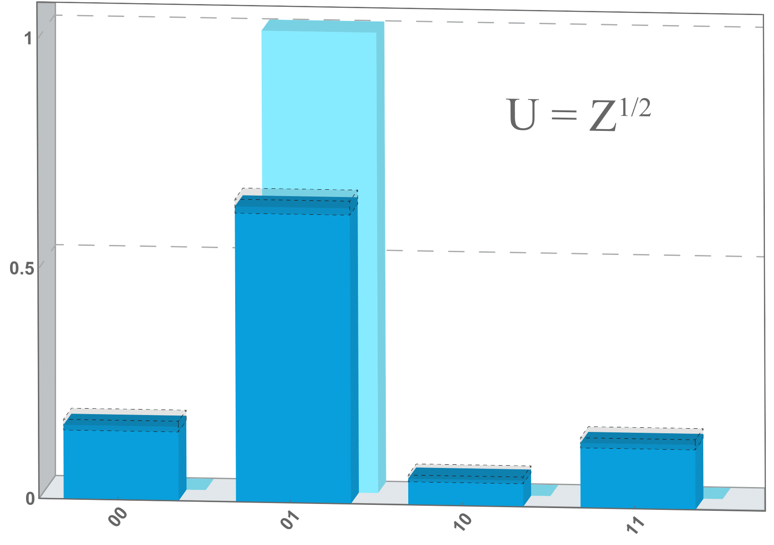
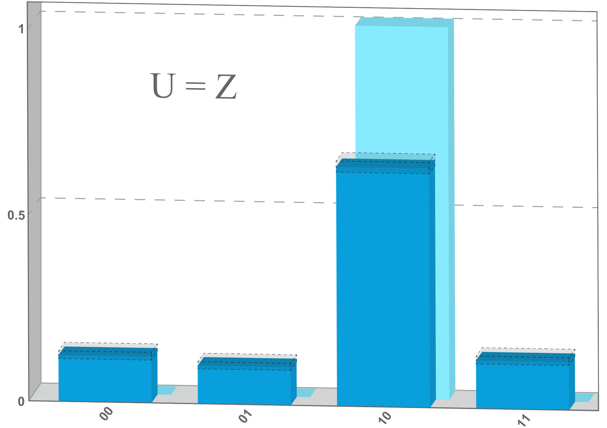
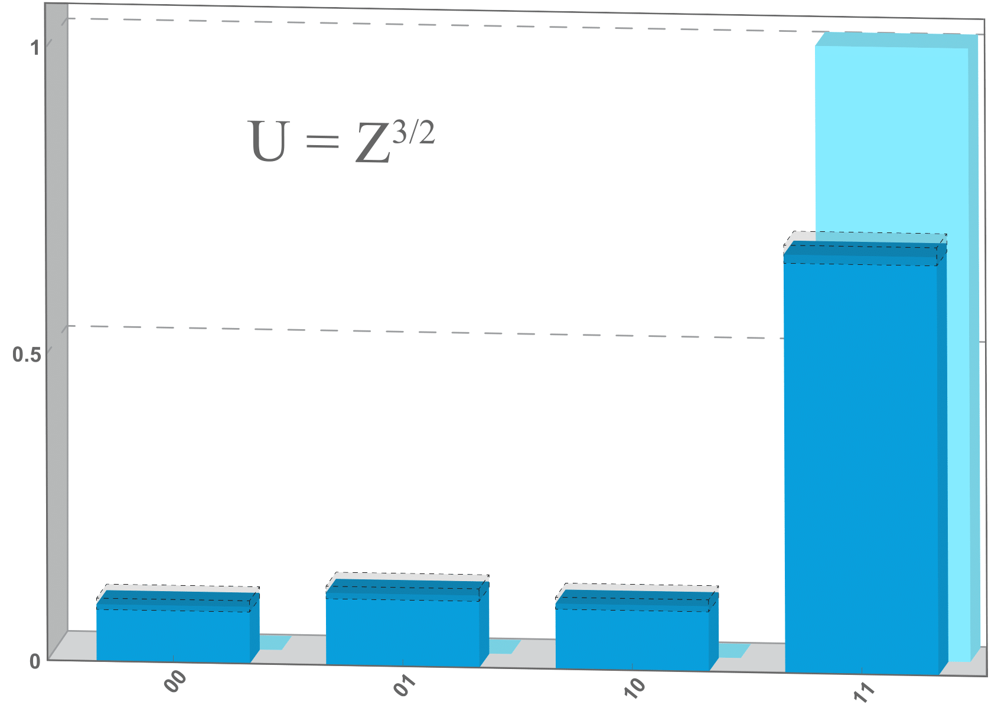
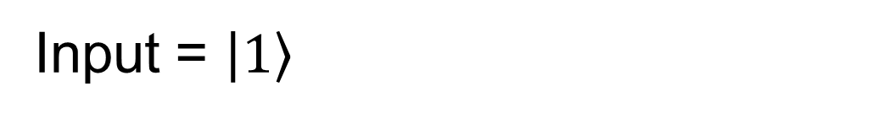
Phase estimation
Test for measuring phases of 0, π/2, π, 3π/2
Input = $\left.\left|1\right.\right\rangle$
Output register
1
U = I
U = Z^{1/2}
U = Z
U = Z^{3/2}
0.5
0
00
01
10
11
00
01
10
11
00
01
10
11
00
01
10
11
arXiv:2112.14589 (2021)

Slide 15
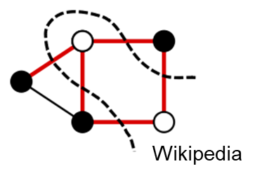
Quantum Approximate Optimization Algorithm (QAOA)
QAOA can be thought of as a discretized (Trotterized) version of adiabatic evolution.
Start the system in the ground state of a mixer Hamiltonian.
Alternate application of mixer and problem Hamiltonian.
Update weights (classical optimizer) of mixer and problem steps to arrive at ground state of problem Hamiltonian.
Example: MaxCut graph problem. Divide the vertices of a graph into two sets to maximize the number of cuts across the set boundary.
Classically hard – no polynomial time classical algorithm that can find the optimal solution for arbitrary graphs.
Farhi & Goldstone (2014)
classical weights
H_{mixer}
H_{problem}

Slide 16
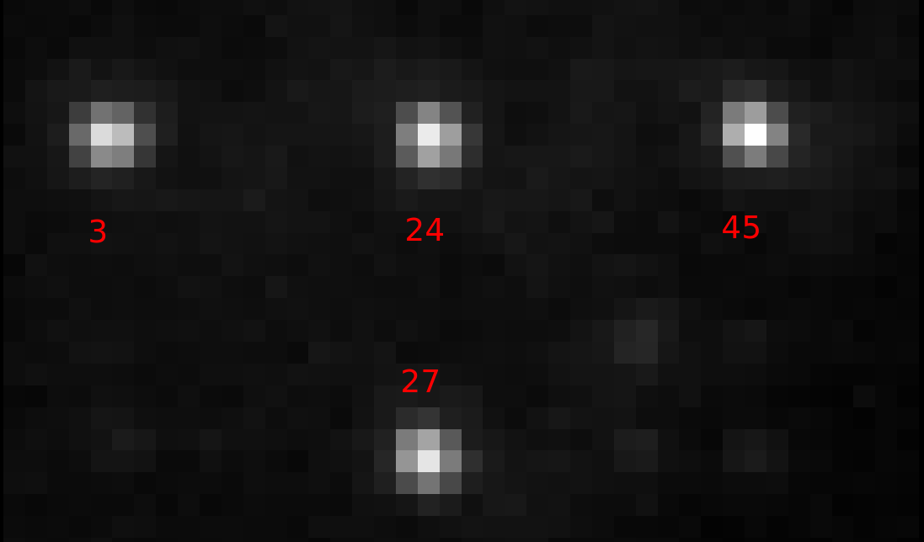
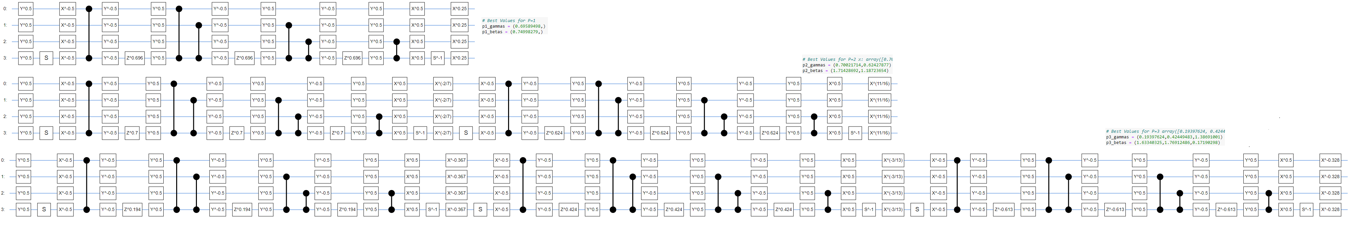
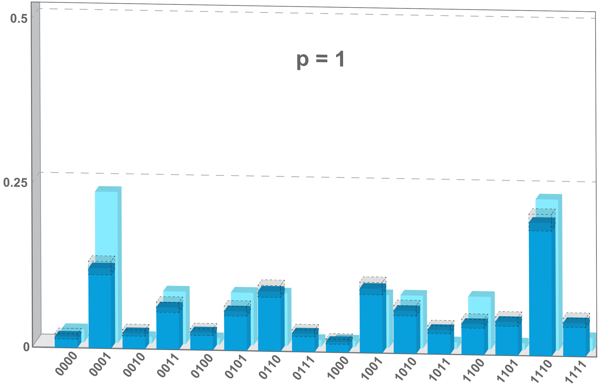
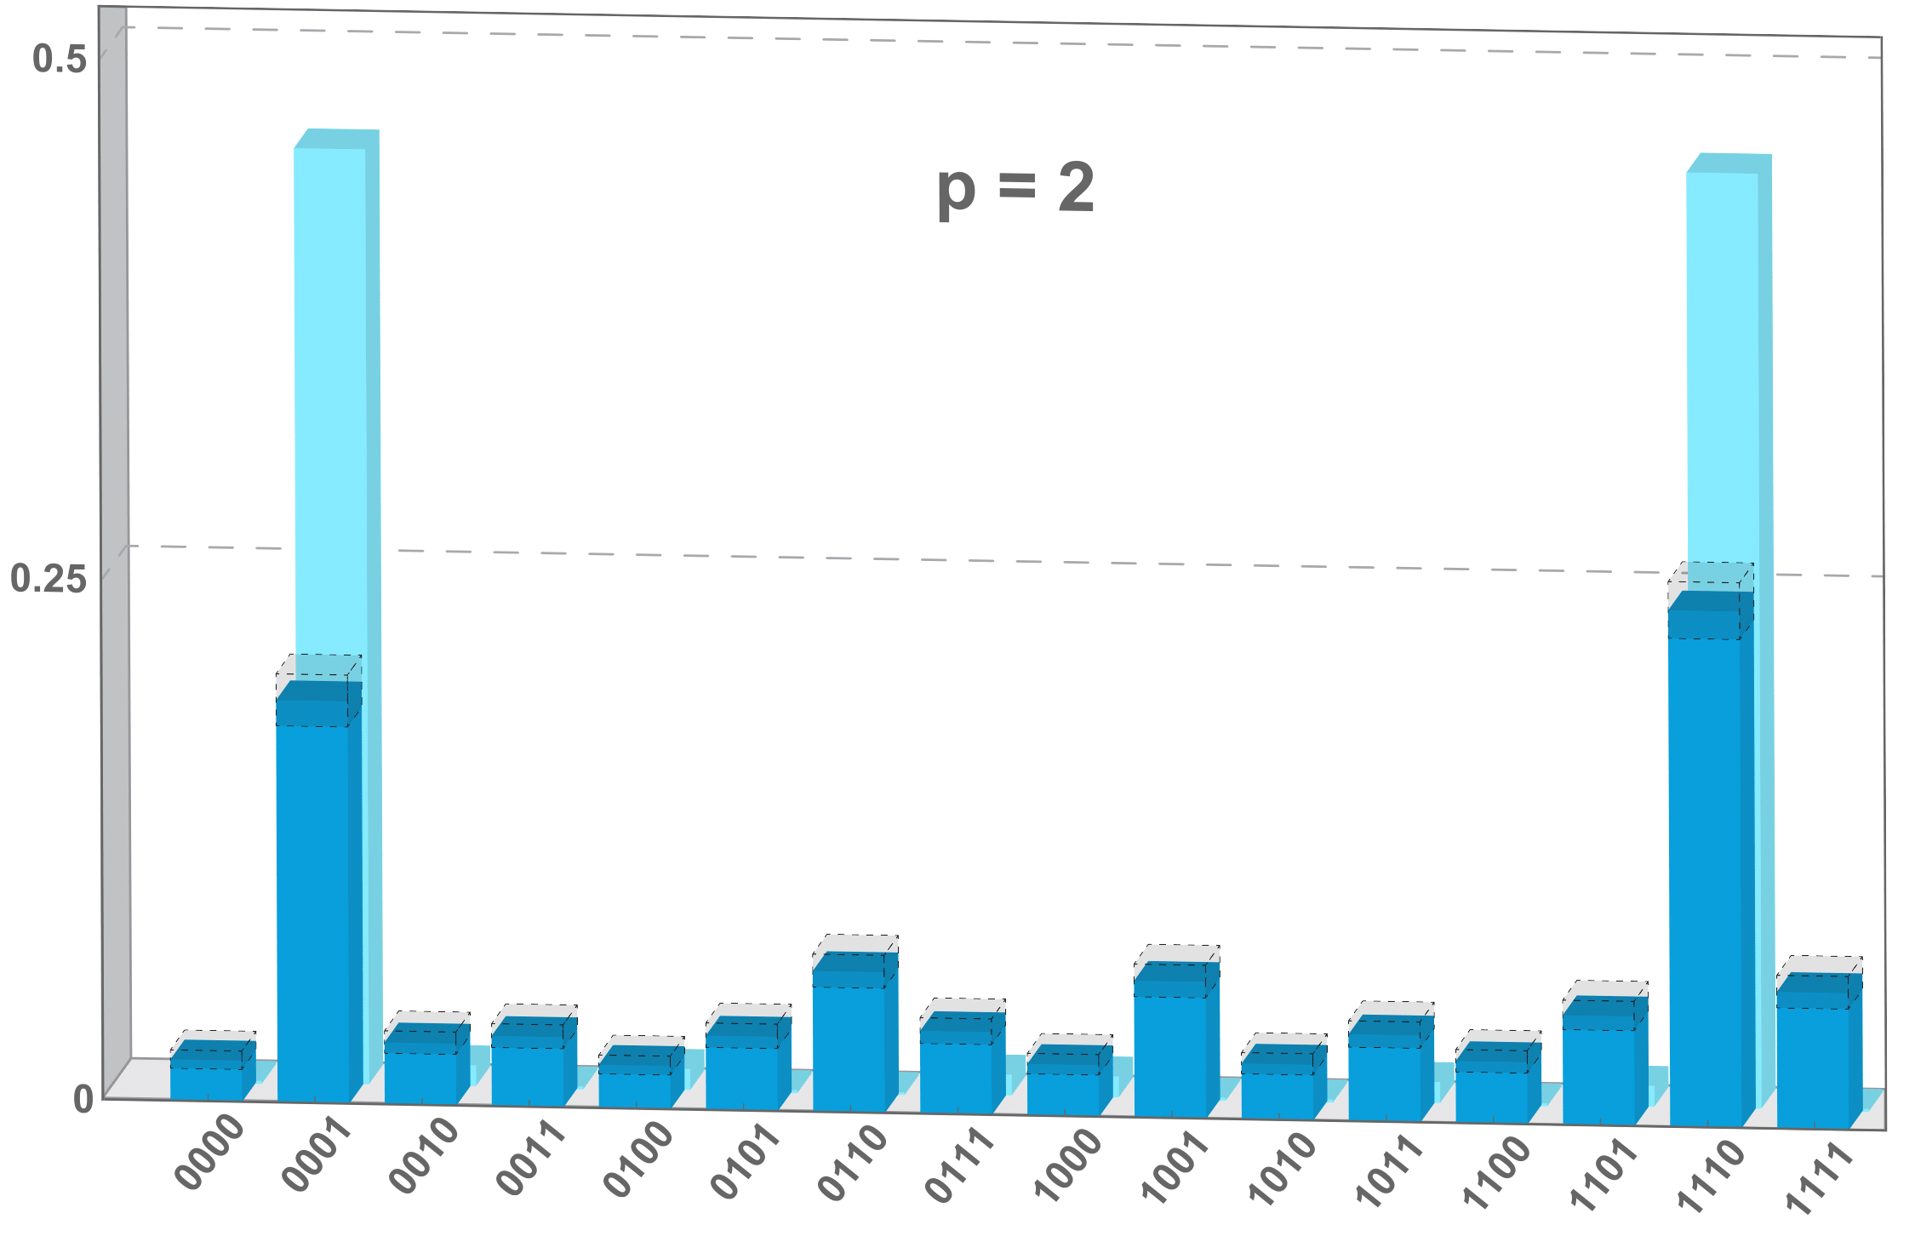
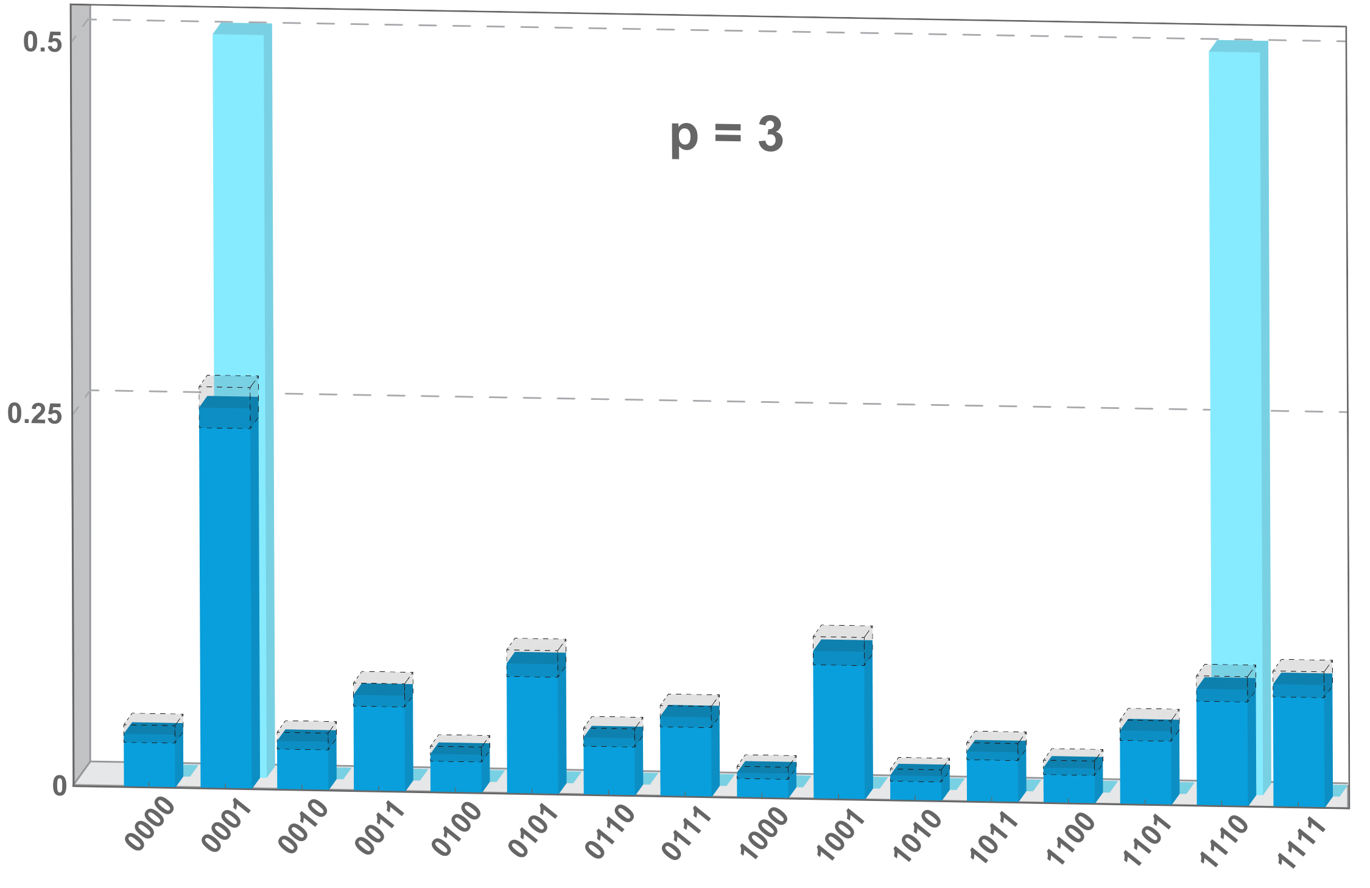
QAOA MaxCut – 4 qubits
QAOA for 4 node MaxCut
q0
q3
q2
MaxCut solutions are 0001 and 1110
Noise free prediction for p=1,2,3 is AR=0.77,0.95, ~1.0
q1
6 CZ
12 CZ
18 CZ
arXiv:2112.14589 (2021)
p=1
AR=0.67
p=2
AR=0.69
p=3
AR=0.63

Slide 17
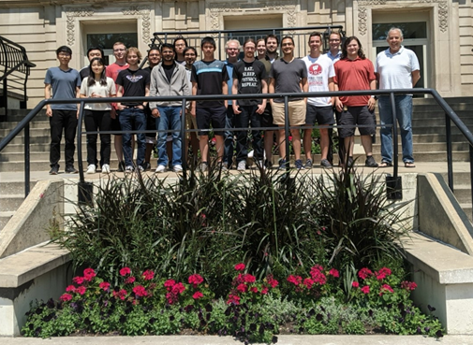
Atomic quantum computing outlook
The Atomic Qubit Array (AQuA) at UWM has demonstrated first quantum algorithm results with a gate model neutral atom quantum computer.
Currently have high fidelity state preparation, measurement, and 1Q gates.
Moderate fidelity 2Q gates, close to F=0.96, with improvement expected from further progress in laser cooling / optics / system automation.
Neutral atoms are an inherently scalable platform and we anticipate continued advances in the coming year.
Cloud availability in 2022 from ColdQuanta.
July, 2021

